Slide 1
A Framework for Binding and Retrieving Class-Specific Information to and from Image Patterns using Correlation Filters
Authors: Vishnu Naresh Boddeti
B.V.K Vijaya Kumar
Presentation made by: Vishal Asnani

Slide 2
OBJECTIVE
A framework for securely binding information to image patterns is proposed.
This information is mapped into parameters for geometric image transformations like rotation, scaling, translation, etc.
The training images are transformed based on these parameters to create a template using transformed images.

Slide 3

Proposed Framework
A template is designed from a set of images representative of the pattern class,
These templates are stored in a database along with any class-specific information.
This template is matched to the query pattern for classification.
This class-specification information is released only upon a successful match between the template and query pattern.
During authentication stage, spatial translation parameters are extracted by cross-correlating the query and template to further extract the key.
= Data-dependent weighting matrix for each transformed image
J = Projective transformation of image I by projection matrix T

Slide 4
Properties of the designed template
Revocability
Security
Performance
diversity

Slide 5

Correlation Filters
A spatial-frequency array i.e. a template in the image domain designed from a set of training images that are representative of a particular class.
The template is compared to a query image by obtaining the cross-correlation as a function of relative shift between the template and the query.
C(u, v) = I∗(u, v)F(u, v)
CFs produce sharp peaks in the correlation output which is achieved by minimizing the Average Correlation Energy (ACE), along with some regularization
Where ,C= 2D FT of the correlation output
I= FT of query pattern
F= FT of CF
Depending on the choice of the ideal correlation plane g, the solution to the above optimization lead to the common unconstrained CF designs.

Slide 6
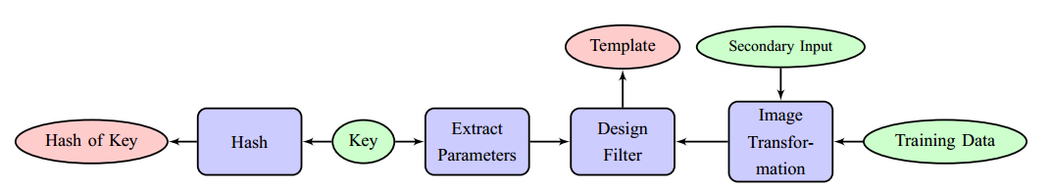
Proposed Framework
Enrollment
Fig 1: Block diagram of the training phase of the framework
Following things are required at this stage:
Training images representative of the authentic class
Information or key to be bound to the template.
A secondary input for additional protection.

Slide 7
Proposed Framework cont..
Image Transformation
Images are transformed before being used to design CF so as to prevent information leakage.
A matrix with random values is generated using a user provided password as seed, which is convolved with the gallery images and a CF is designed.
During testing, the probe image is supplied along with a password which determines the random mask.
The probe is convolved with the random mask and is correlated with the CF.
The effect of random mask is cancelled out during the correlation operation if the probe password provided by user is correct.

Slide 8
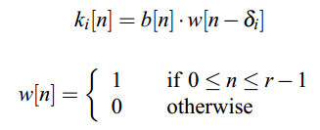
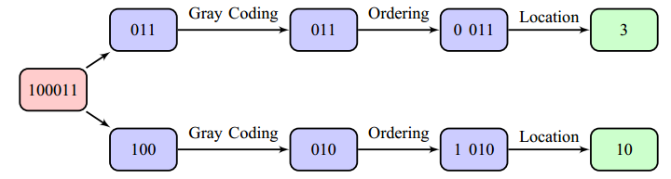
Proposed Framework cont..
The key is segmented into smaller segments of appropriate size to map the information into the locations in the correlation plane.
Each segment of the key is mapped to a peak location in the correlation plane.
These locations are used to get the ideal correction output g to design the CF for the given class and key pair.
b = bit representation of the key
r = window size
K_{i} = i-th key segment

Slide 9
Proposed Framework cont..
The centroid of the specified peak locations is stored in the database as there is some global shifting the peaks due to relative shifts between training and query images.
For images of size d1 xd2 and a key with m bits, the number of peaks and the window size are related as follows,
q(log₂ d1 + log₂ d2) ≥ m + q log₂ q
r = [m/q]
where [] denotes the ceiling operation

Slide 10
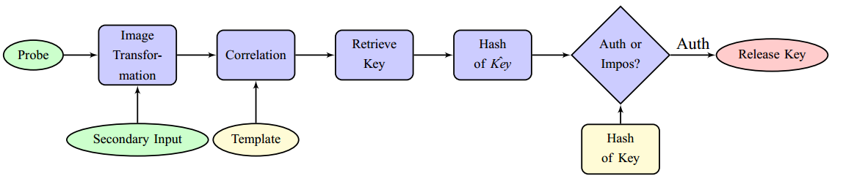
Proposed Framework cont..
II. Authentication
Block diagram of the testing phase of the framework
The query image is cross-correlated using the CF corresponding to the claimed class.
If the query is authentic, the resulting correlation should have peaks at the right locations.
The information bound to the template is then reconstructed.
Only when the hash value of the recovered information is matched with the stored hash value, the information is released

Slide 11
Robust key retrieval
Problem in identifying the peaks and the peak locations in the correlation plane due to variable imaging conditions or sensor noise.
This problem is solved by following procedure:
Denoising the correlation plane
Use of probabilistic estimates to determine the number of peaks and peak locations.
Correcting residual errors in the peak locations using error correcting codes.

Slide 12




Robust key retrieval cont..
I. Exploiting Sparsity for Denoising
Reconstructing the correlation plane with A as DFT matrix by minimizing the l₀ norm instead of l₂ norm of the resulting correlation output will result in a less noisy correlation plane.
Replacing the L₀ norm with L₁ norm will result in the same solution for sufficiently sparse correlation outputs.
As the desired sparsity T0 (and T1 ) is unknown, we solve the below l₂ − l₁ problem which is also called Basis Pursuit Denoising:
We choose the value of τ that gives the best denoised correlation plane.

Slide 13
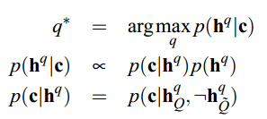

Robust key retrieval cont..
II. Probabilistic Framework for Decoding
The peaks in the correlation plane needs to be identified in the presence of noise which can be done using a threshold on the correlation values.
The idea of a fixed threshold for separating the peaks from noise is not efficient due to image variabilities.
A probabilistic analysis is performed to detect peak locations.
We probabilistically map values of the correlation output to a posterior probability value on the existence of a peak.
We model the prior distribution of each peak for each hypothesis h^{q} as a binomial distribution

Slide 14
Robust key retrieval cont..
II. Probabilistic Framework for Decoding
The peaks in the correlation planes are sometimes not very sharp which makes the peak locations being off by a couple of pixels.
ECC is used to correct this problem.
ECC can be applied in two types:
At the segment level for each segment that the key is mapped into
At the key level before mapping it into segments.
Binary BCH codes are used in both the cases.
Gray coding is applied on the key to ensure that the degradation pattern in the retrieved key is proportional to the degradation pattern in the correlation plane.

Slide 15

Security Analysis
Three scenarios are discussed to assess the performance of the proposed framework:
Brute Force Security
The adversary has access only to the template f and the centroid of the peak locations.
The adversary can retrieve the key only by guessing the number and location of peaks in the correlation plane.
The key space in bits that the adversary has to search over is:
When using ECC, the error correction capability of the code reduces the security of the key.
The reported range for the security is given by [L(q) − 4tq, L(q) − 2tq].

Slide 16
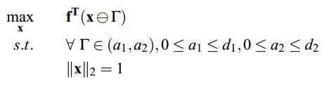
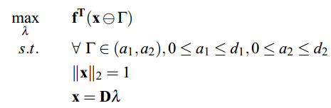
Security Analysis cont..
2. Dictionary attack
The adversary has the information on secondary input
The adversary would need to estimate an unknown number of transformations given image f.
Given f, an estimate of the signal x can be obtained by solving the following optimization problem
The adversary has access to an image model x = Dλ where D ∈ R^{Nxt} is a dictionary for x which helps reduce the search space from x ∈ R^{N} to λ ∈ R^{t}.

Slide 17
Security Analysis cont..
3. Substitution Attacks
Attacker has access to user’s secret key.
Attacker can design a template his/her using own biometric signature.
Proposed algorithm is ineffective against such attacks.
A solution for this problem could be to hash the template or digitally sign the template to secure it from tampering

Slide 18
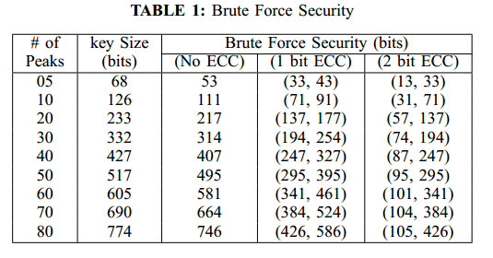
Experimental Results
Performance of the proposed framework is reported in terms of Information retrieval failure rate (IRFR) and false class information retrieval rate (FCIRR).
Experiments were conducted with images of size 128 x 128 to bind randomly generated keys of length between 20 and 770.
Several databases are used to demonstrate the performance of the framework:
CMU PIE
CMU Multi PIE
PolyU
FRGC

Slide 19
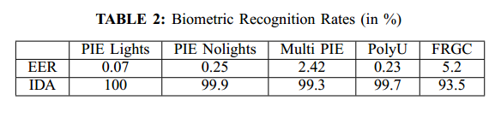
Experimental Results cont…
Biometric authentication
The table below shows the results without binding information to the CFs
The Rank-1 identification accuracy (IDA) as well as the Equal Error Rate (EER) for all the databases is reported
2. Known key size
Number of peaks q* in the correlation plane is known
Peaks which are in wrong locations are corrected by ECC and this may cause some error
Majority of the errors made with shorter keys are due to the poor quality of the query image
Majority of the errors made with longer keys are because of reduced peak sharpness caused by noise in correlation plane.

Slide 20
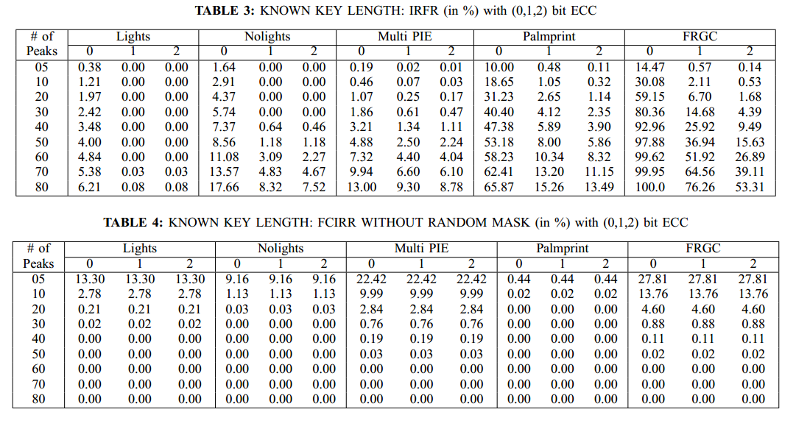
Experimental Results cont…
Key retrieval rates increase with the size of the key.
The performance on FRGC images is worse compared to CMU MPIE.
When using secondary input, zero FCIRR is observed with no ECC, with 1 bit ECC and with 2 bit ECC.
While the FCIRR is high for shorter keys, it quickly drops down reaching zero for longer keys.

Slide 21
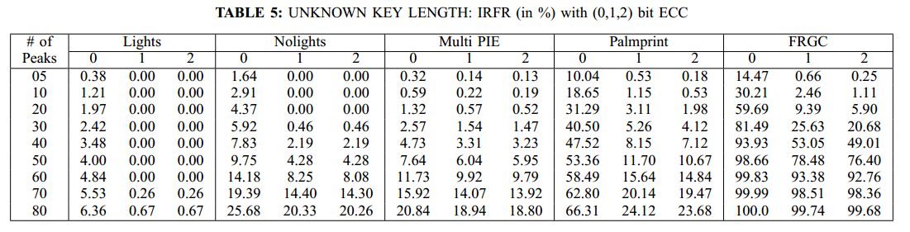
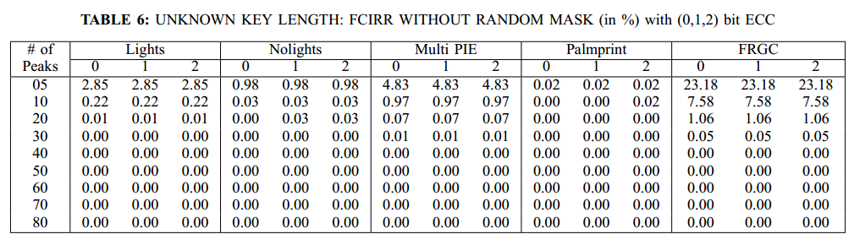
Experimental Results cont…
3. Unknown key size
The key retrieval performance is worse compared to the scenario where the key size is known
It is harder for an imposter to retrieve somebody else's key as shown by FCIRR.

Slide 22
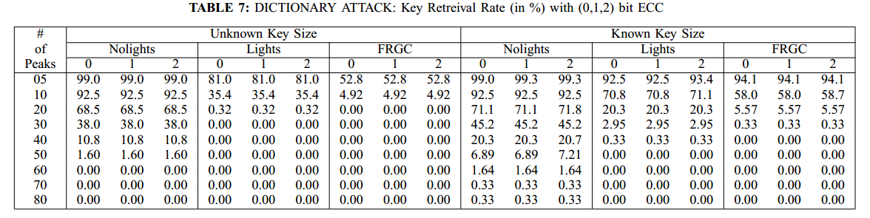
Experimental Results cont…
4. Dictionary attack
The quality of the dictionary determines the success rate of such dictionary attacks.
Attacks against longer keys templates result in poorer image estimates which leads to poorer key retrieval rates.

Slide 23
Spreading Keys over Multiple Patterns
Spreading the keys over multiple pattern classes is an important feature as it opens up biometric key-biding to many different security configurations.
There are two ways in which we can spread keys over multiple patterns:
Multi-modal: We use faces and palm prints as the two biometric modalities over which we spread keys.
Multi-class: We randomly pair users while ensuring that the unique pairing is done.
CF is applied individually to both biometric signatures, keys is extracted from each correlation output and are combined to extract the complete key.
Key retrieval rates fluctuate a lot so to optimize the IRFR, one has to choose the pairs carefully.
IRFR for multi-class and multi-modal case is lower in comparison with the single biometric scenario.
IRFR performance is improved as the number of peaks per image is reduced.

Slide 24
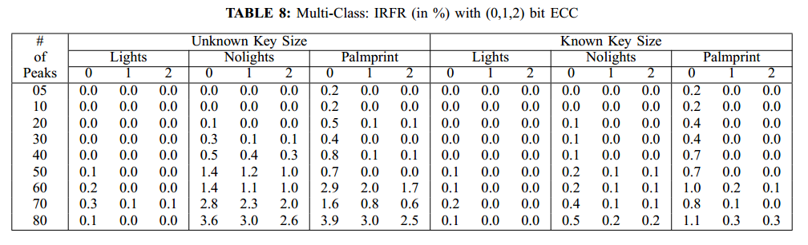
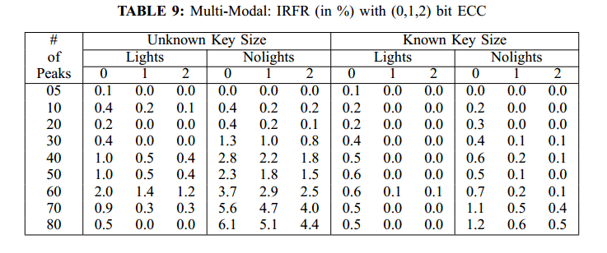
Spreading Keys over Multiple Patterns cont..

Slide 25
Limitations
The framework proposed has some limitations given below:
Limited robustness to large appearance variance as shown by FRGC results
Limited robustness against dictionary attacks.

Slide 26
Conclusion
A framework to bind information to image patterns and retrieve it by providing proper authentication is proposed.
This framework can robustly retrieve keys up to 250 bits with IRFR under 6% and nearly zero FCIRR.
It can be used to spread keys over multiple users and over multiple biometric modalities and classes.

Slide 27
THANK YOU

